Slide 1
SLEUTH + ZIPKIN
Kim Saabye Pedersen

Slide 2

SLEUTH – to track or follow

Slide 3
SLEUTH
Add (assuming spring-cloud BOM) to pom.xml:
<dependency> <groupId>org.springframework.cloud</groupId> <artifactId>spring-cloud-starter-sleuth</artifactId> </dependency>
Now your logs look like this:
2016-06-06 09:27:34.341 INFO [appName,889d464470a393fe,889d464470a393fe,true]
appName: the name of your app as defined by spring.application.name
889d464470a393fe: the correlationId (aka traceId in Spring Guide)
889d464470a393fe: the id of the specific operation (spanId)

Slide 4
And so what….
In a distributed system you want this.
2016-06-06 09:27:34.341 INFO [appName,889d464470a393fe,889d464470a393fe,true]
In this case correlationId == spanId: Graph started by this “invocation”.
2016-06-06 10:19:07.841 INFO [appName,f6ad402cbcb55b2c,47c5cc5f1b4692,true]
If correlationId != spanId:
traceId comes from other app or you created a new span.
And now you can correlate your logs.

Slide 5
DEMO
sluethDemoApp: http://localhost:9987
someApp: http://localhost:9547

Slide 6
What Spring gives you
A lot of instrumentation to keep correlation ids across:
Http & RestTemplate (incl. async)
ExecutorService + RxJava
Messaging
Hystrix
+ a way to roll your own.

Slide 7
Under the hood
cs - Client Sent - The client has made a request. This annotation depicts the start of the span.
sr - Server Received - The server side got the request and will start processing it. If one subtracts the cs timestamp from this timestamp one will receive the network latency.
ss - Server Sent - Annotated upon completion of request processing (when the response got sent back to the client). If one subtracts the sr timestamp from this timestamp one will receive the time needed by the server side to process the request.
cr - Client Received - Signifies the end of the span. The client has successfully received the response from the server side. If one subtracts the cs timestamp from this timestamp one will receive the whole time needed by the client to receive the response from the server.

Slide 8
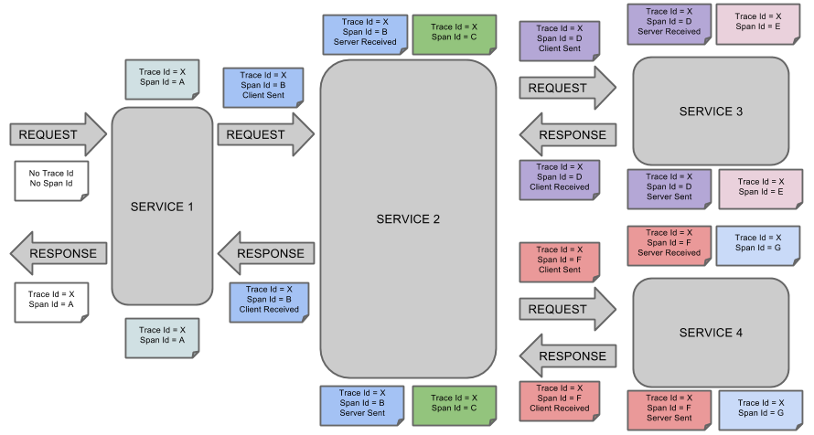
An example

Slide 9

ZIPKIN
Zipkin – aggregation of spans (in-mem, db)
Zipkin UI – query, analyze, visualize spans
http://localhost:9966

